Slide 2
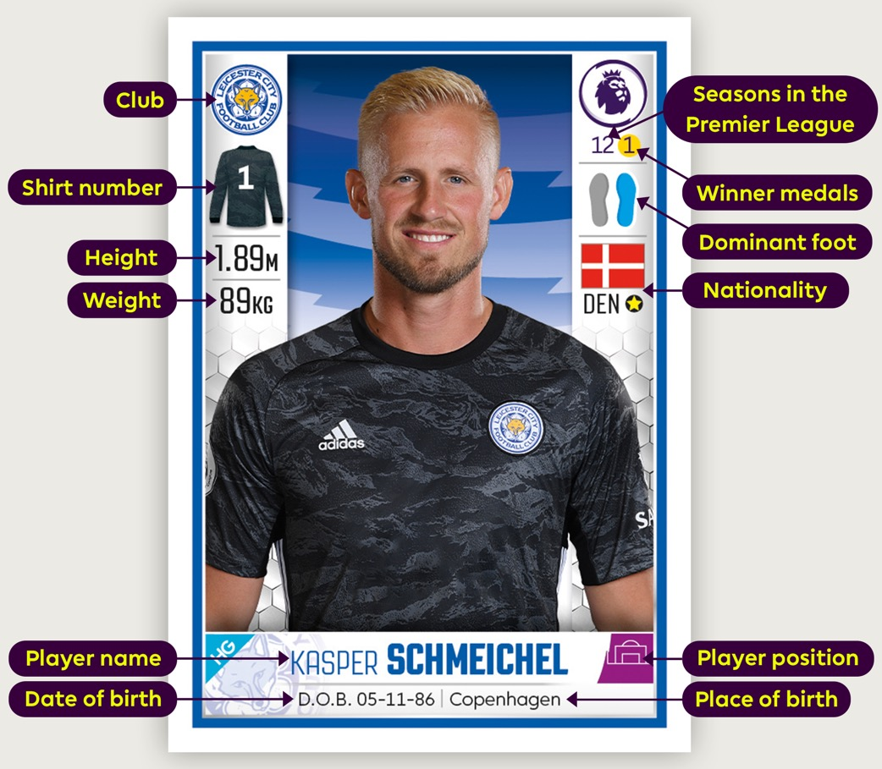
Sticker stats
Use these player stats to solve the following football puzzles.
Notes:
Use this labelled profile to explain the data fields presented.

Slide 3
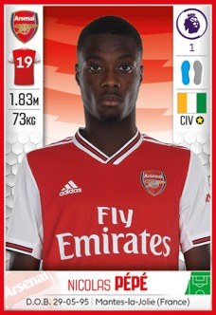
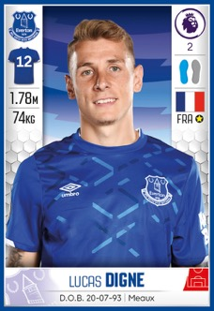
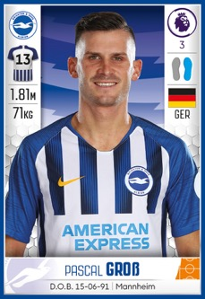
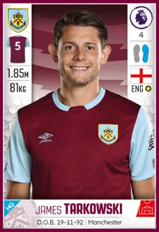
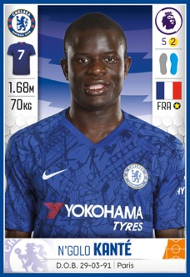
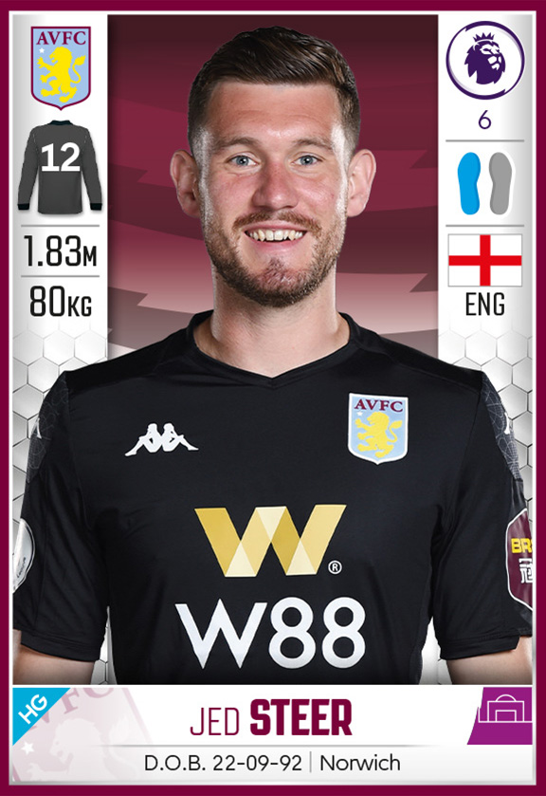
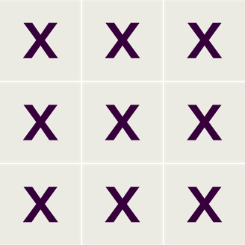
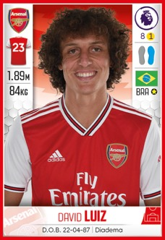
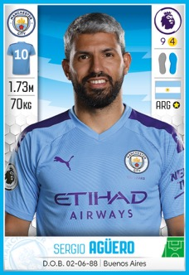
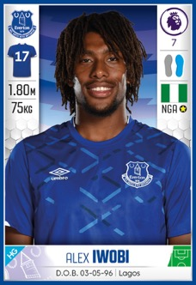
Puzzle formation
Nine players are in training before the final.
They start passing the ball to each other using
grids in this formation.
As the manager, you want a good balance
of experience working together.
Notes:
Puzzle formation (slide 1 of 2)

Slide 4
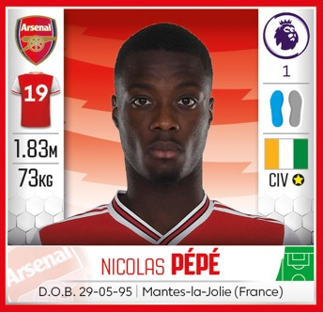
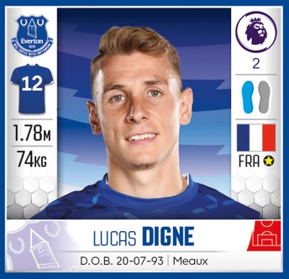
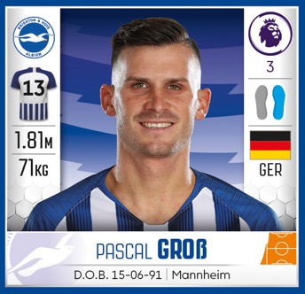




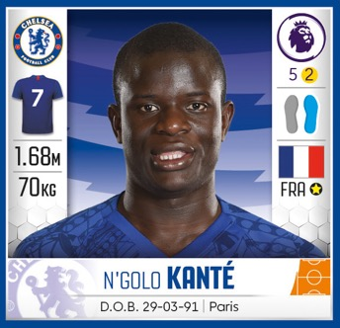




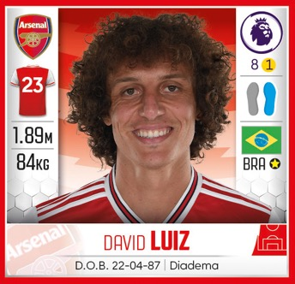
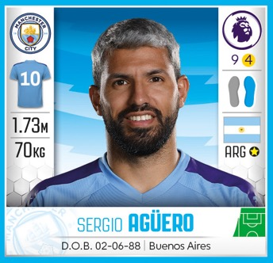
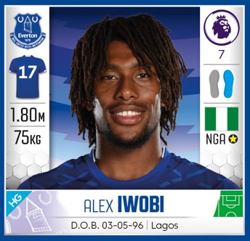



Puzzle formation
Look at the number of seasons in the
Premier League for each player: from 1 to 9.
Can you position the 9 players so that all their season numbers add up to 15 across each row and 15 down each column?
Notes:
Puzzle formation ANSWERS (slide 2 of 2)
ANSWER: 2 7 6
9 5 1
4 3 8

Slide 5
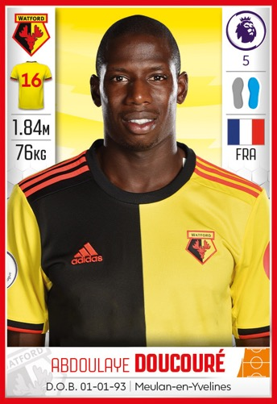
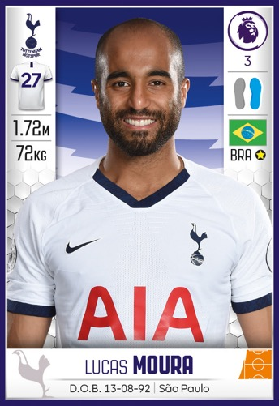
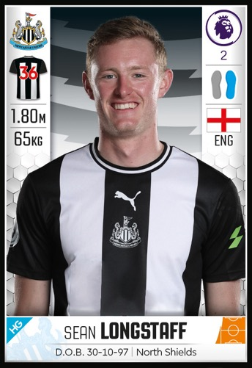
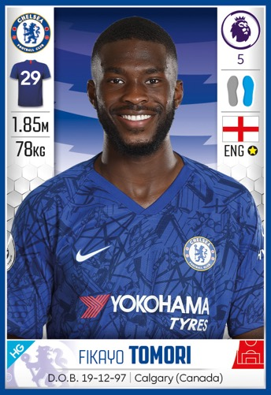
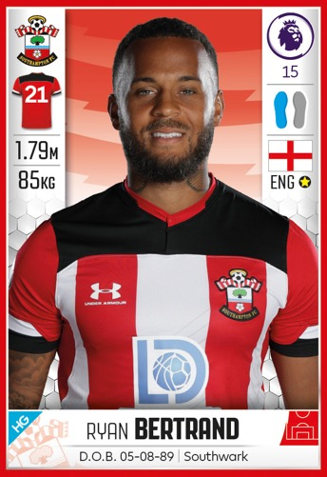
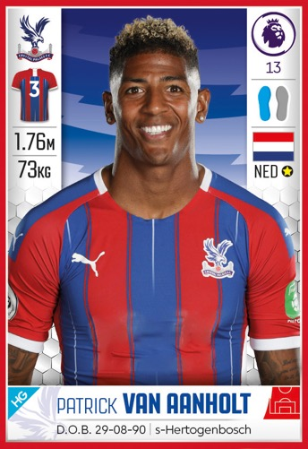
Missing shirt
As the Kit Manager you are preparing the team’s kit ahead of the match, but there is one shirt missing!
The shirt number is 2 digits.
It is less than 50 but more than 20.
The sum of the 2 digits is 9.
The difference between the 2 digits is 3.
Whose shirt are you looking for?
Notes:
Missing shirt - ANSWERS
ANSWER
Order of elimination:
Van Aanholt – 3 – shirt number is less than two digits
Doucouré – 16 – shirt number is not more than 20
Tomori – 29 - sum of the two digits is not 9; red herring to test vocabulary with the digit 9
Bertrand – sum of the two digits is not 9
Moura – 27 – the difference between the two digits is not 3
Longstaff – 36 – Correct Answer

Slide 6

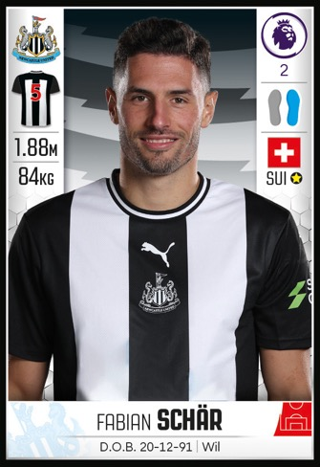
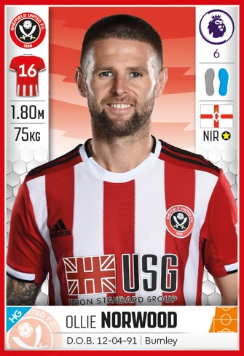
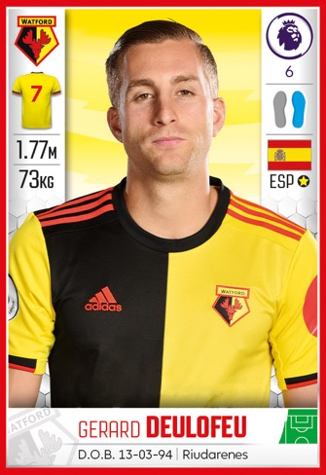
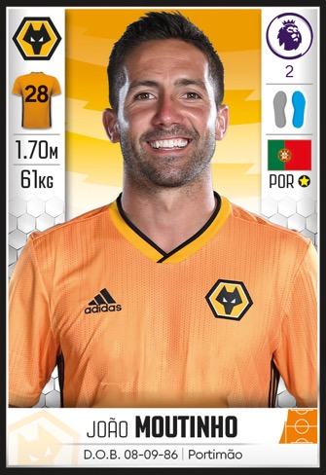
Roman confusion
The players have had a medical and as the Club Doctor you’re entering their statistics onto the database.
Disaster! The computer has changed all the numbers into Roman Numerals and one player’s stats has been entered incorrectly.
Notes:
Roman confusion – (slide 1 of 2)

Slide 7





Roman confusion
Whose stats are incorrect?
Seasons in PL
Day of Birth
Height in cm
Weight
Shirt number
XV
XX
CLXXX
XXVIII
XXVIII
Notes:
Roman confusion ANSWERS (slide 2 of 2)
ANSWER
Gerard Deulofeu - his weight of 73kg should be represented as LXXIII.
Hint:
There is one here over 100 as a challenge for those working at greater depth.

Slide 8
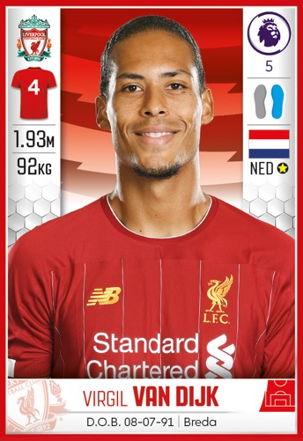
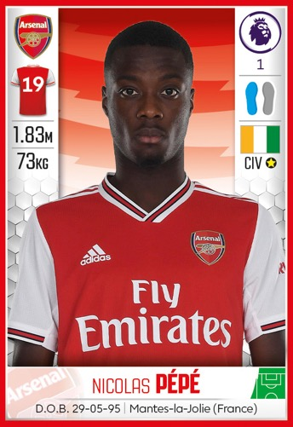
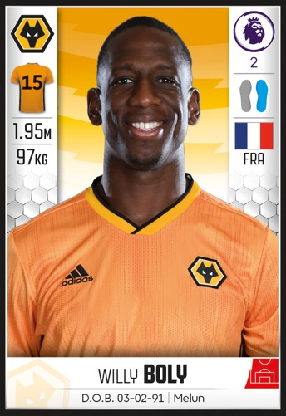
Team selection
As the Manager you can only select 5 players to complete the starting team.
You can only select players who have
shirt numbers which are:
Multiples of 9.
Square numbers.
Prime numbers.
Which player is left to sit on the bench?
Notes:
Team selection
Suggest children write the numbers in separate squares or circles and cross out as they eliminate the answers.
ANSWER
Order of elimination:
Moura- Tottenham – 27 – This one is the only multiple of 9
Doucouré - Watford- 16 / Van Dijk - Liverpool – 4 – These are the only square numbers
Pépé - Arsenal- 19 / Tomori- Chelsea – 29 – The only prime numbers
Boly - Wolves– 15 – Correct Answer

Slide 9
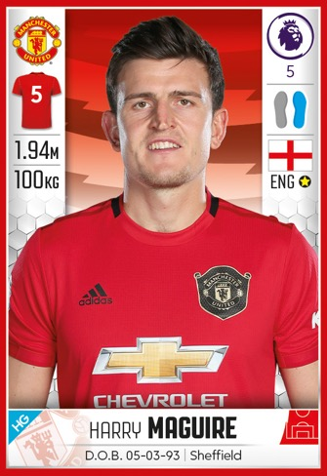
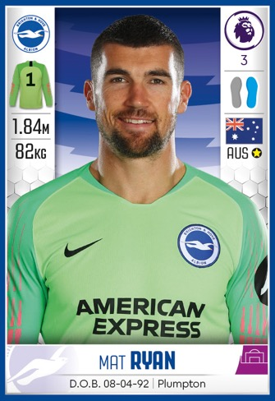
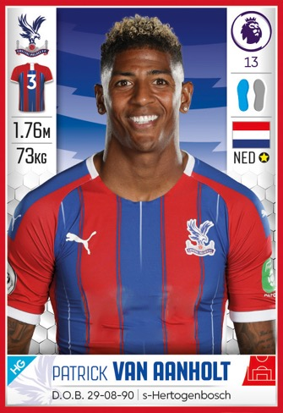
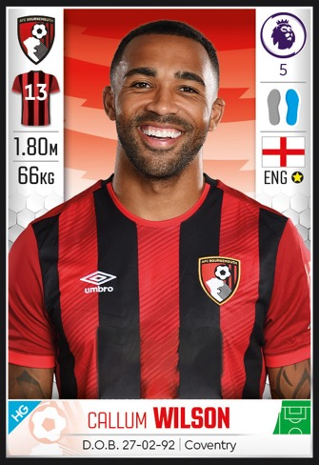
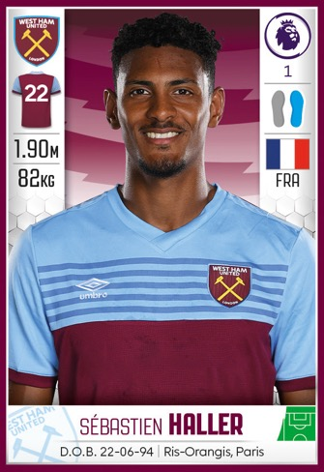
Team photo
As the Club Photographer you’ve been asked to take a team photo of a selection of Premier League players who will be taking part in a 5-a-side charity match.
Can you help get the players into position?
Notes:
Team photo (1 slide of 2)
Puzzle submitted by Bobby Seagull.
This activity is best manipulated or drawn. You could either print and cut out the profiles OR write each player’s fact down, cut out and move around.

Slide 10


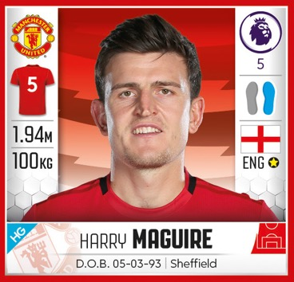

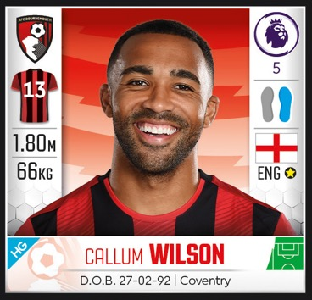
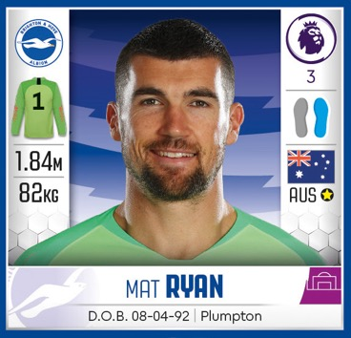
Team photo
Can you help get the players into position?
Player A is the tallest player
Player B is the goal keeper
Player C is shorter than the players in the front row
Player D is 4 cm shorter than player B
Player E is 10 cm taller than player D
Notes:
Teacher notes ANSWERS (slide 2 of 2)
ANSWER
A = Harry Maguire (1.94m)
B = Mat Ryan (1.84m)
C = Patrick Von Aanholt (1.76m)
D = Callum Wilson (1.80m)
E = Sébastian Haller (1.90m)

Slide 11
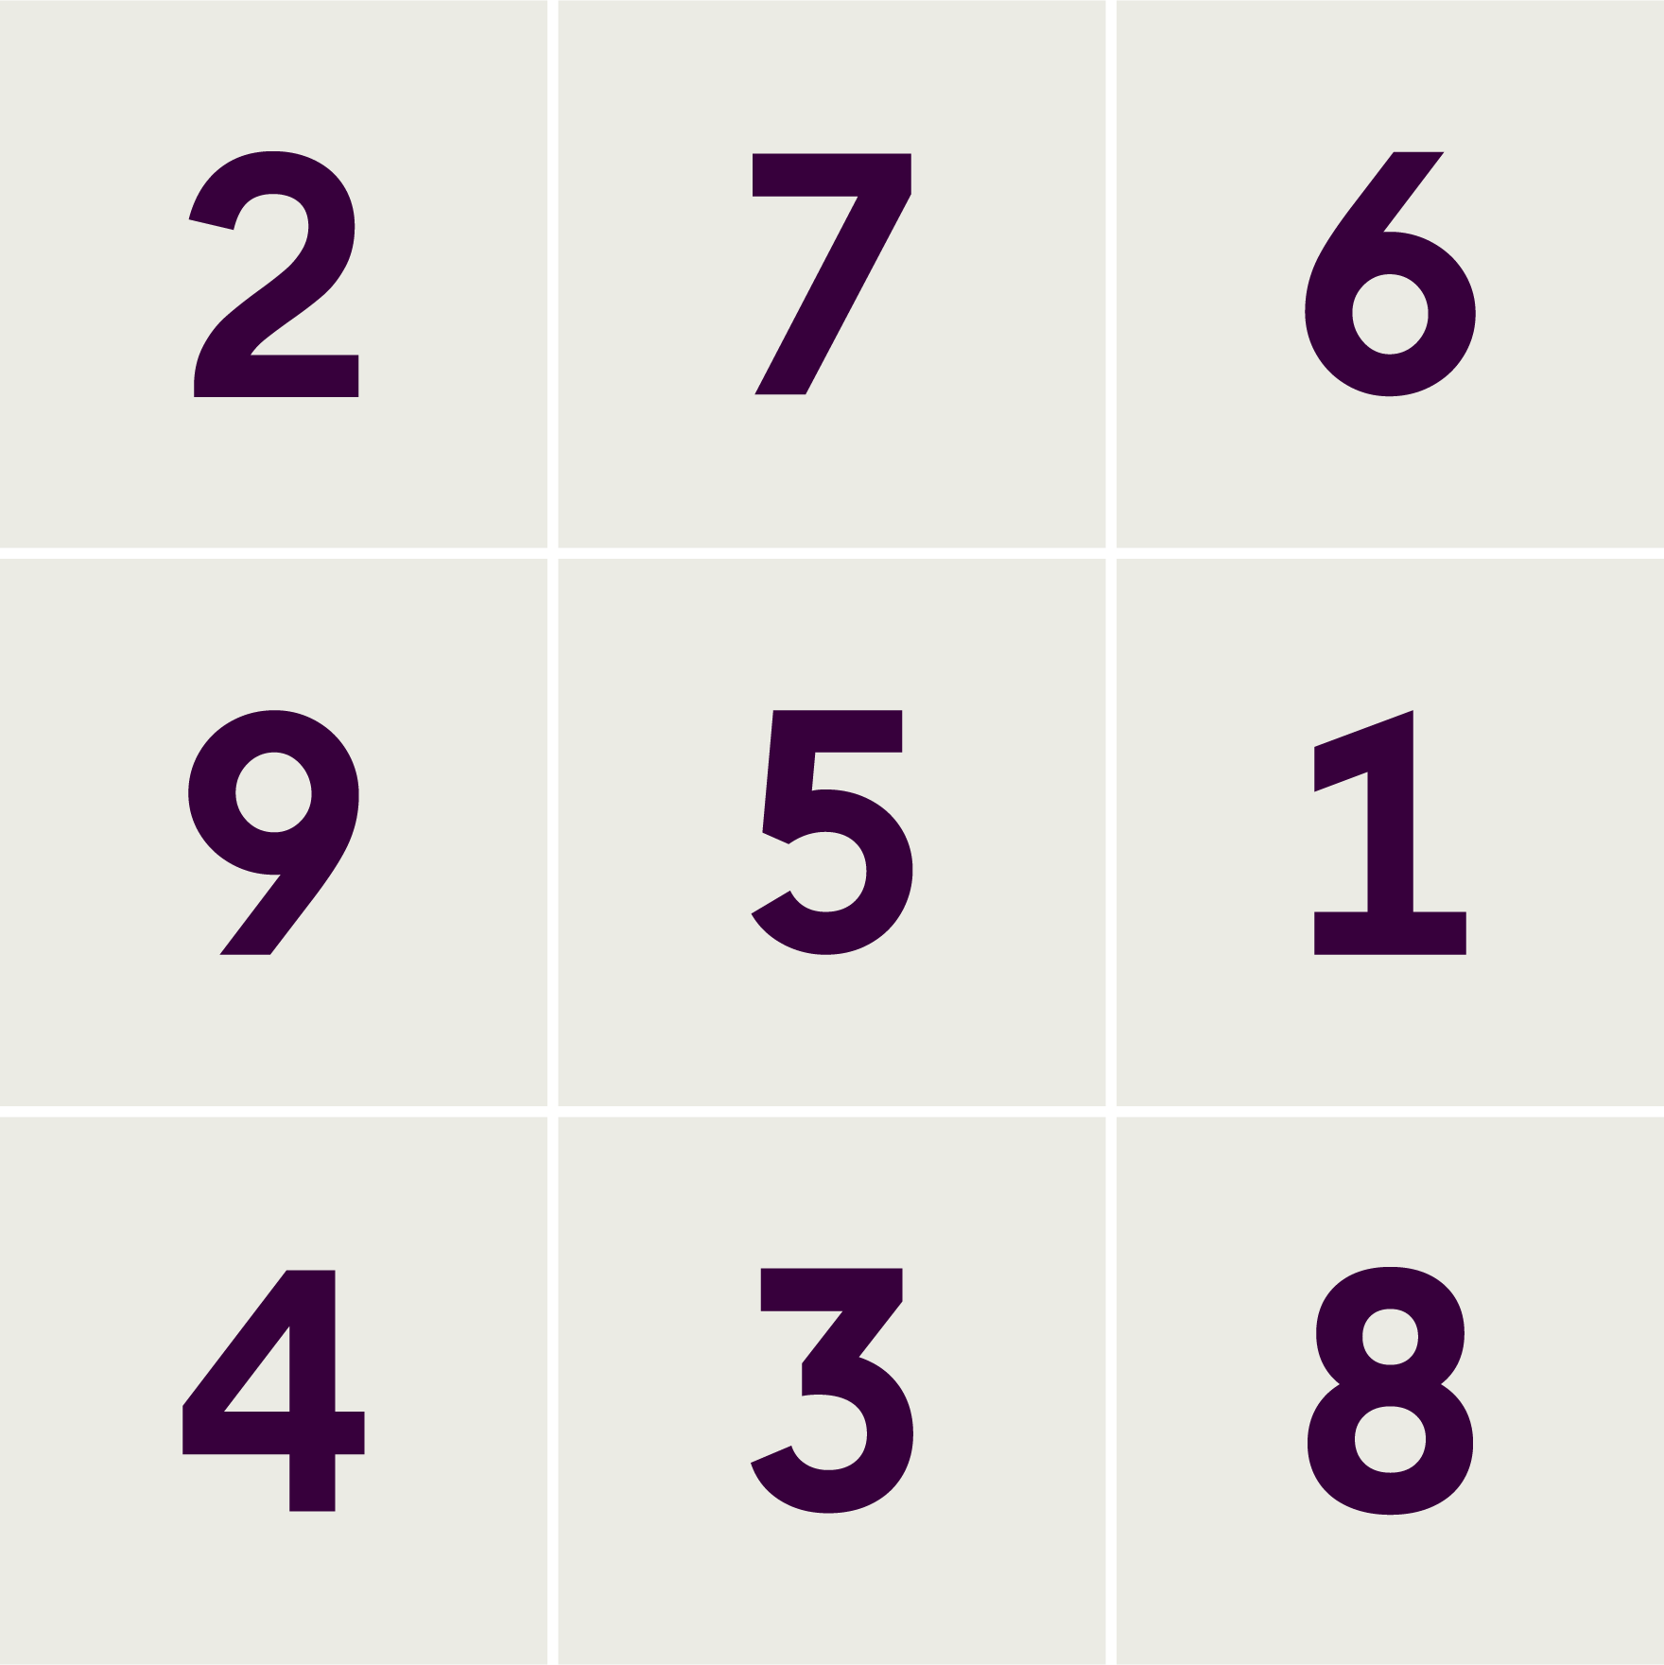
Answers
Puzzle formation
Missing shirt
Order of elimination:
Van Aanholt – 3 – shirt number is less than two digits
Doucouré – 16 – shirt number is not more than 20
Tomori – 29 – sum of the two digits is not 9;
red herring to test vocabulary with the digit 9
Bertrand – sum of the two digits is not 9
Moura – 27 – the difference between the two digits is not 3
Longstaff – 36 – Correct Answer
Roman confusion
Gerard Deulofeu
His weight of 73kg should be represented as LXXIII
Team selection
Order of elimination:
Moura – Tottenham – 27
This one is the only multiple of 9
Doucouré – Watford – 16 / Van Dijk – Liverpool – 4
These are the only square numbers
Pépé – Arsenal – 19 / Tomori – Chelsea – 29
The only prime numbers
Boly – Wolves – 15 – Correct Answer
Team photo
Harry Maguire (1.94m)
Mat Ryan (1.84m)
Patrick Von Aanholt (1.76m)
Callum Wilson (1.80m)
Sébastian Haller (1.90m)

